Slide 1
SURVEY SYSTEM
BY
GUNASEELAN N(21CSR059)

Slide 2
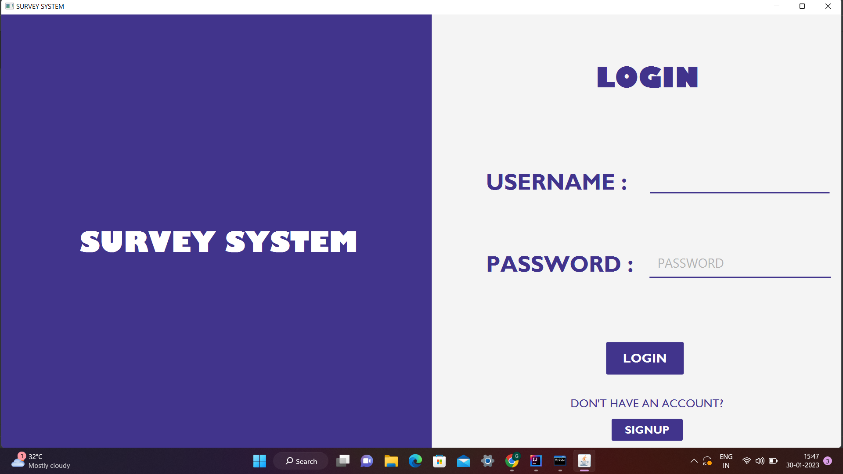
LOGIN PAGE

Slide 3
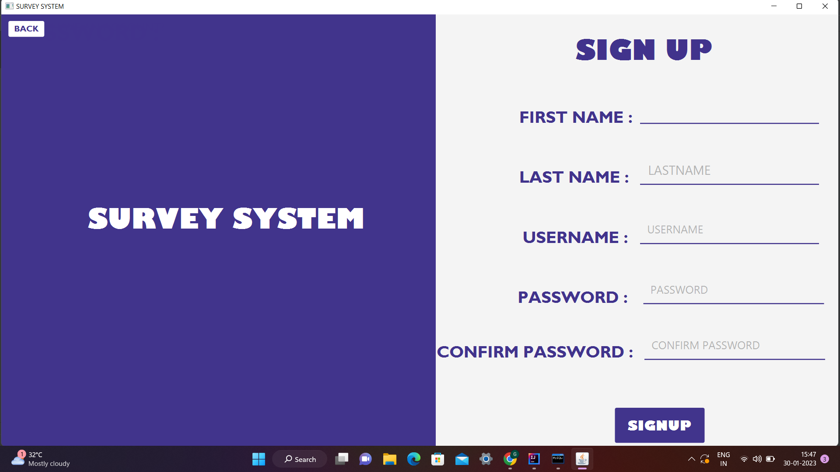
SIGNUP PAGE

Slide 4


Slide 5


Slide 6
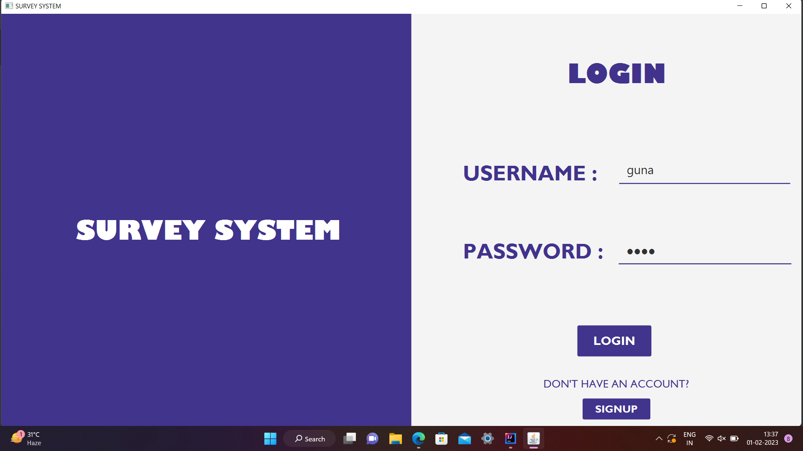

Slide 7
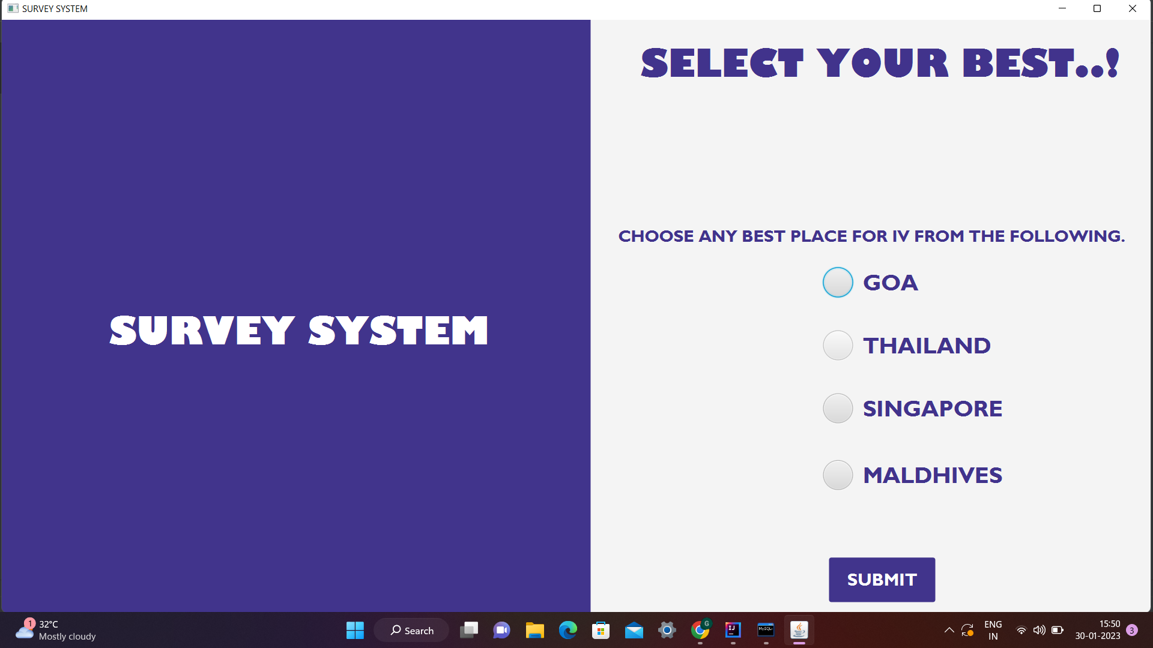
SURVEY

Slide 8
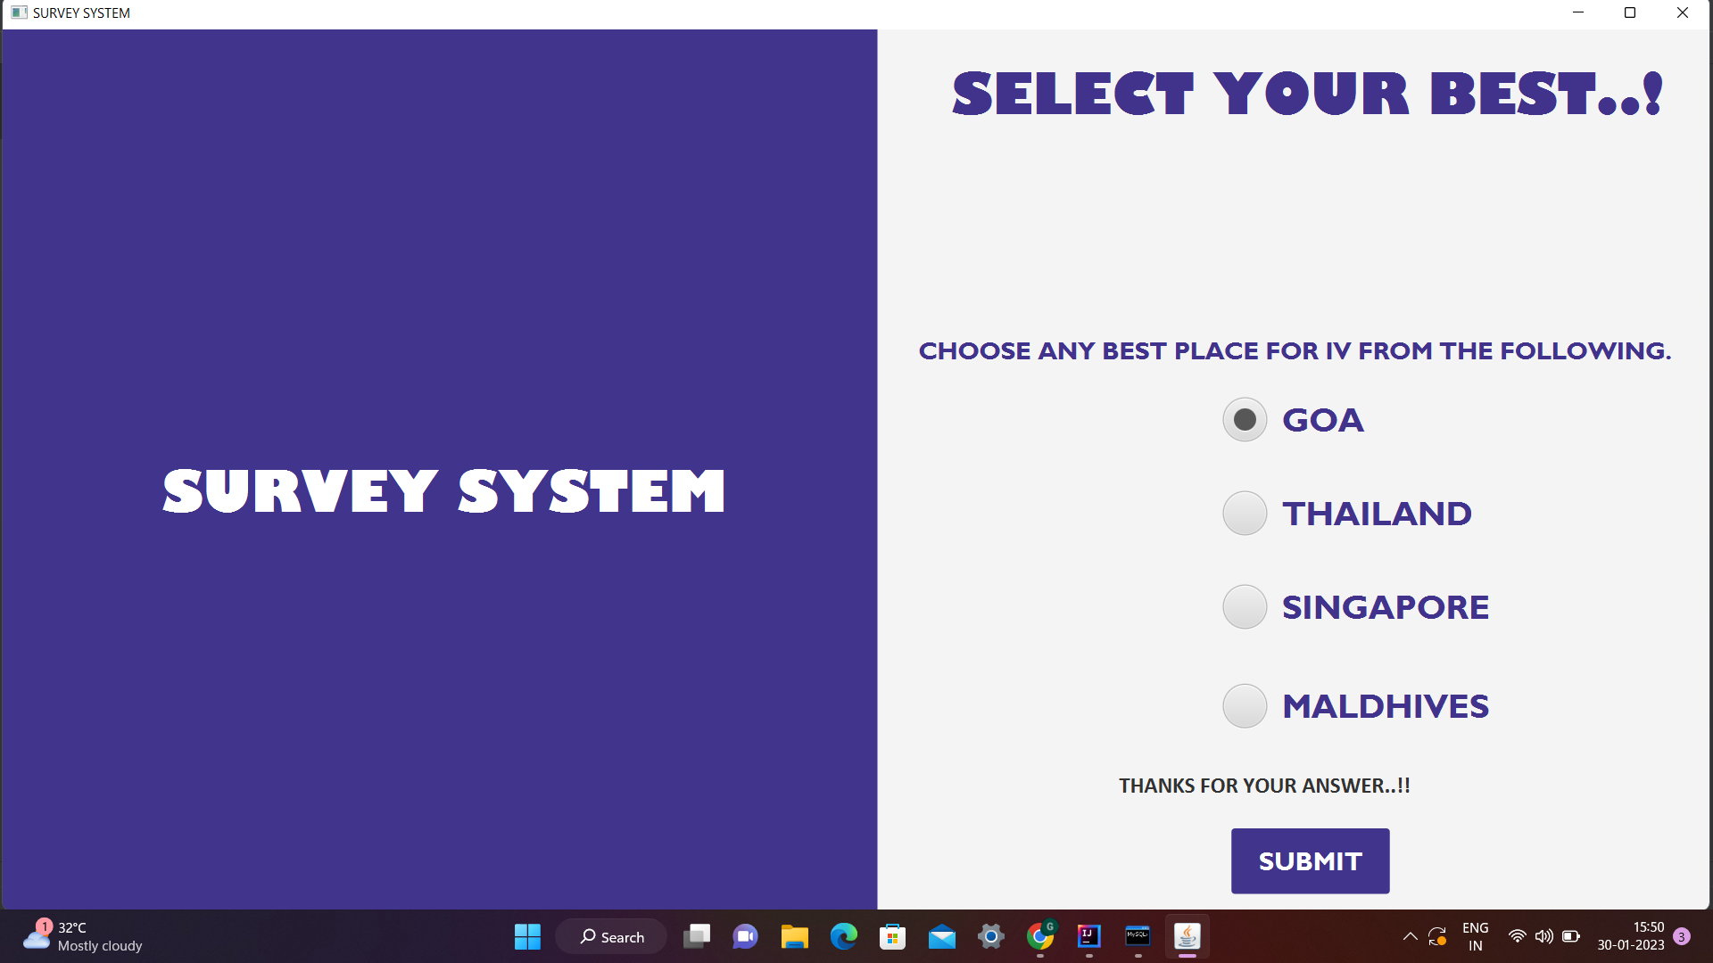

Slide 9
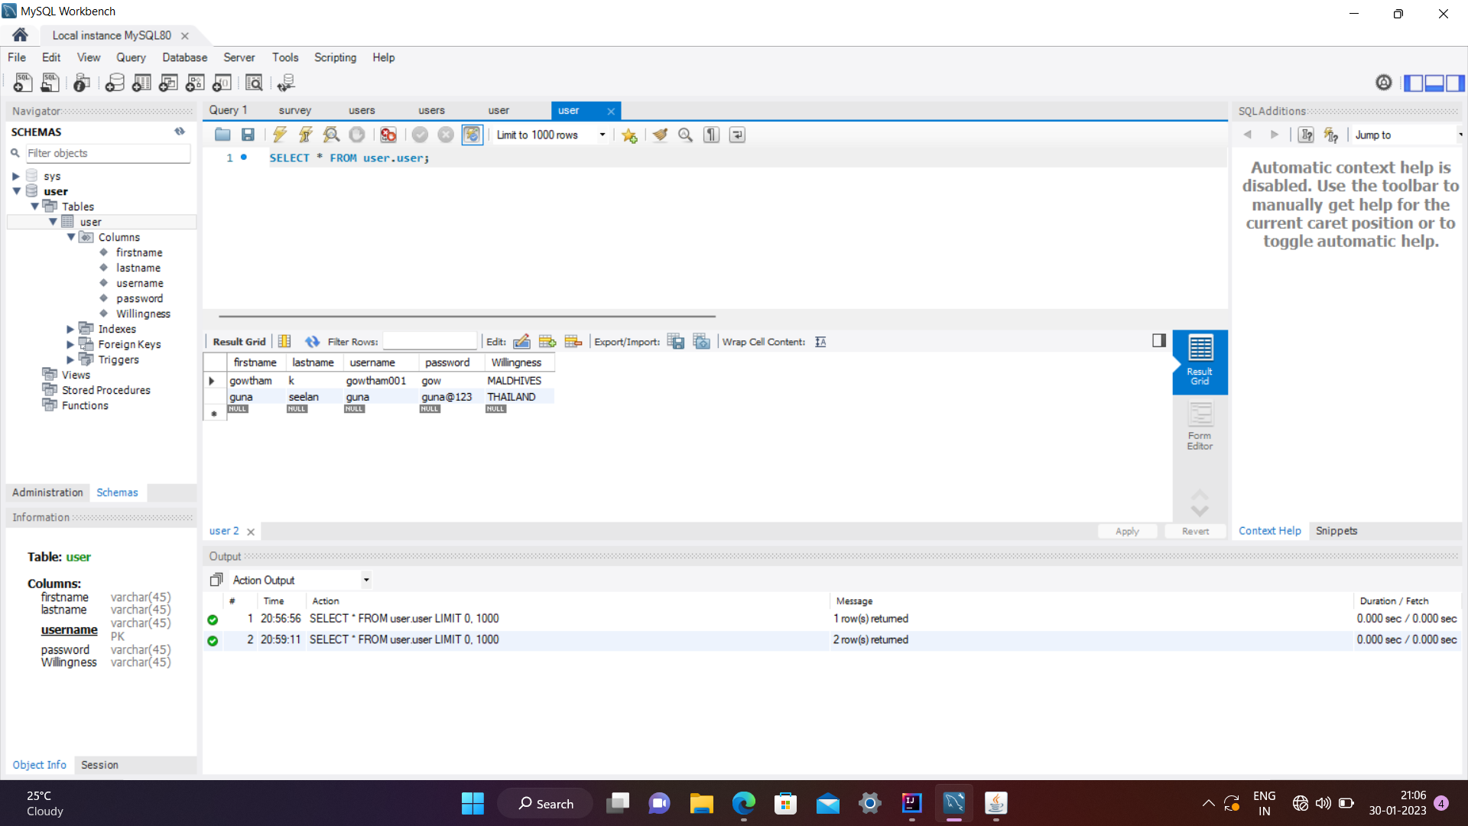
DATABASE

Slide 10
THANK YOU.....

